Slide 1
Cloud Computing
Presented By –
Atharva Puranik JA 307

Slide 2

What is Cloud Computing?
Cloud computing is the delivery of various services over the internet, including storage, computing power, databases, networking, software, analytics, and intelligence. These resources are provided on-demand by cloud service providers, allowing users to access and manage their data and applications remotely rather than relying on local hardware or infrastructure.

Slide 3
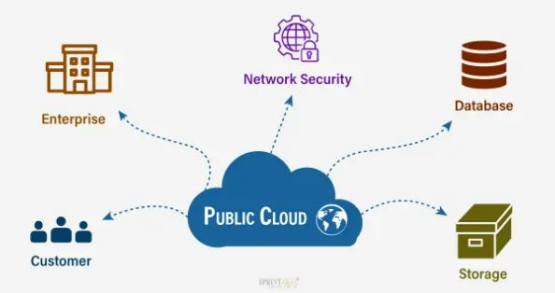
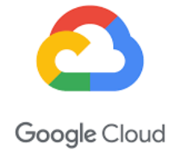

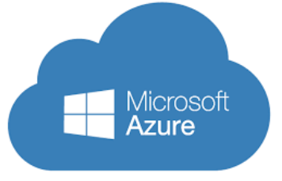
Types of Clouds
Public Cloud:
Hosted by third-party providers
Accessible over the internet
Cost-effective and scalable
Example: Amazon Web Services (AWS), Google Cloud, Microsoft Azure

Slide 4
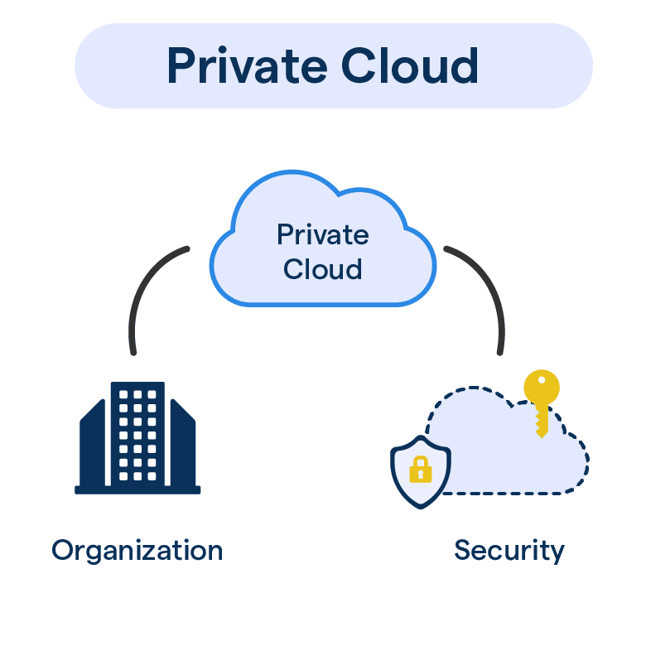


Types of Clouds
Private Cloud
Used exclusively by a single organization
Offers more control and security
Can be hosted on-premises or by a third-party provider
Example: VMware, OpenStack

Slide 5
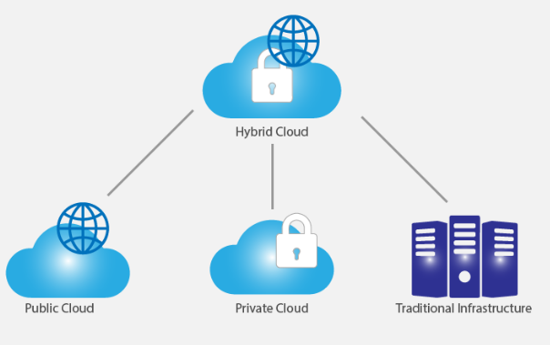
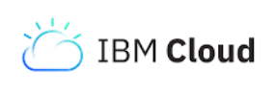
Types of Clouds
Hybrid Cloud
Combines public and private clouds
Allows data and applications to be shared between them
Ideal for businesses needing both flexibility and control
Example: IBM Cloud, Microsoft Azure

Slide 6

Major Cloud Providers
Amazon Web Services (AWS):
Leading cloud provider offering a wide range of IaaS, PaaS, and SaaS services.
Microsoft Azure:
Strong hybrid cloud capabilities and support for various development platforms.
Google Cloud Platform (GCP):
Specializes in machine learning, data analytics, and containerization.
IBM Cloud:
Focuses on AI-driven services and hybrid cloud solutions.
Oracle Cloud:
Known for enterprise resource planning (ERP) and database services.

Slide 7
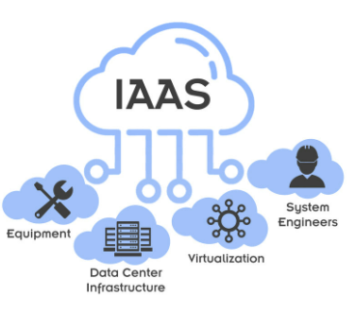
Cloud Service Models
Infrastructure as a Service (IaaS):
Provides virtualized computing resources over the internet.
Users can rent servers, storage, and networking hardware.
Examples: AWS EC2, Google Compute Engine, Microsoft Azure VMs.

Slide 8
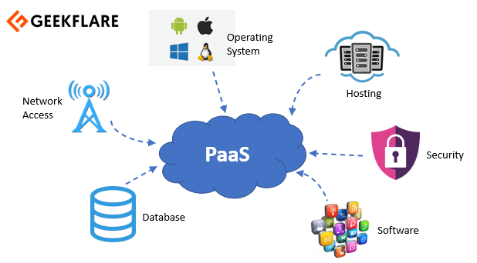
Cloud Service Models
Platform as a Service (PaaS):
Offers a development environment to build, test, and deploy applications.
Developers focus on writing code without managing underlying infrastructure.
Examples: Google App Engine, AWS Elastic Beanstalk, Azure App Services.

Slide 9
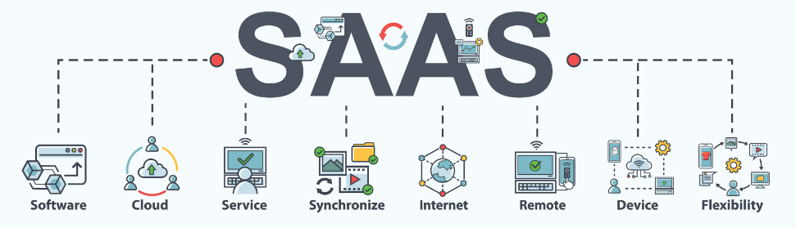
Cloud Service Models
Software as a Service (SaaS):
Delivers fully functional software applications over the internet.
Users access software via browsers, without installation or maintenance.
Examples: Google Workspace, Microsoft 365, Salesforce.

Slide 10
Thank You!!!!

